Slide 1
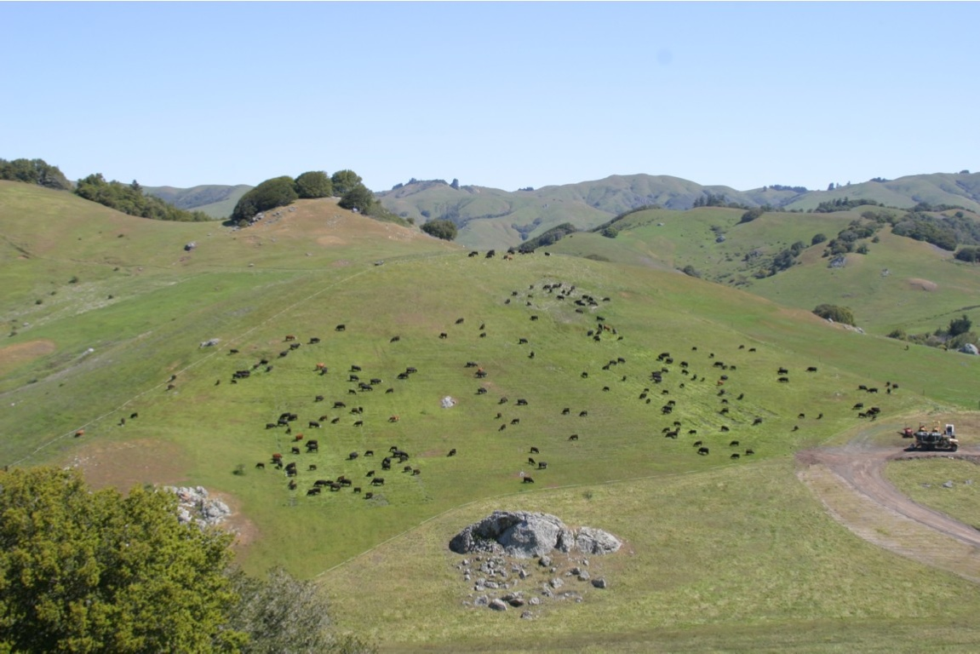
Carbon Farm Planning Through Local Partnerships with RCDs
Soil, Water, Carbon, Climate
Carbon Cycle Institute
www.carboncycle.org

Slide 2
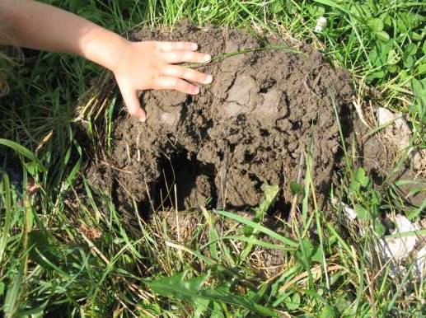
Good News: California -and the World- can meet our GHG reduction goals if we dramatically reduce emissions and invest in our soils and working lands as major sinks for atmospheric carbon. This could be done through Carbon Farming
Photo: Abe Collins, CarbonFarmersofAmerica.org
www.carboncycle.org

Slide 3
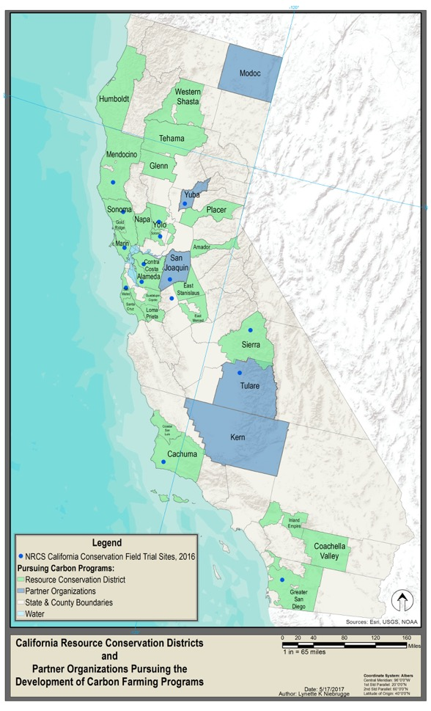
Scaling Up Carbon Farming with RCDs
Why RCDs?
Statewide
Local knowledge
Successful implementation
AND Partners: Fibershed, NRCS, land trusts, Point Blue and others.

Slide 4
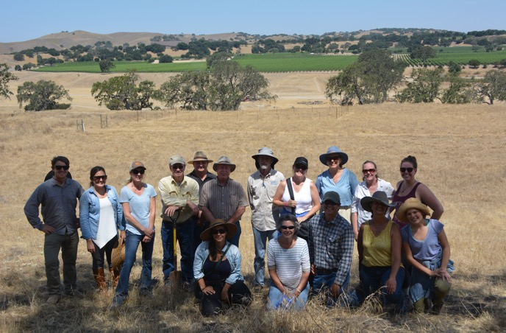
Scaling Up Carbon Farming with RCDs (no need to reinvent the wheel)
RCDs:
Opportunities and challenges
Landowner interest
Practices?
Regulations
Policy: Informing programs

Slide 5
Carbon Farming Support Needed
Technical Assistance
Carbon science
Carbon farm planning
Financial Assistance
Staffing
Practices
Network:
Outreach
Coordination

Slide 6
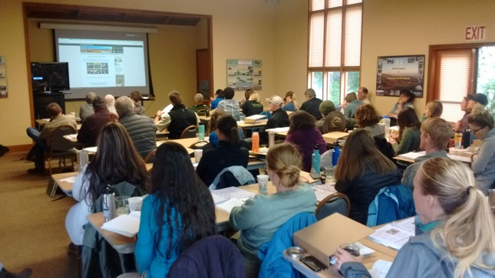
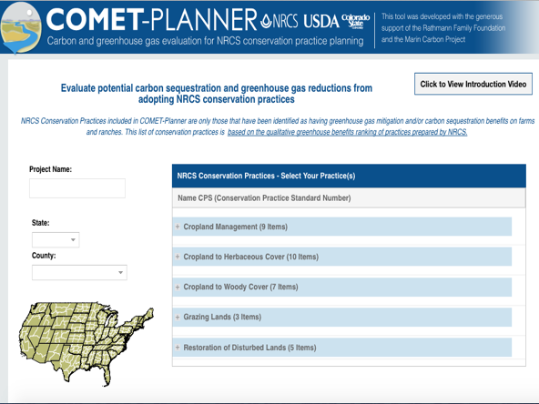
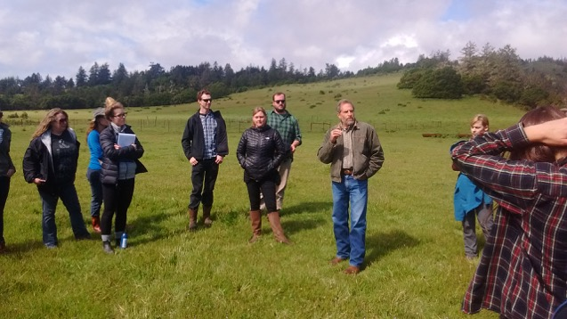
Carbon Farm Planning Training
More than 30 RCDs and other partners have been trained in Carbon Farm Planning using COMET- Planner
COMET – Planners allows RCDs to quantify and communicate the carbon value of their work

Slide 7
Carbon Farming Network
Working in 26 districts
36 carbon farm plans completed or in progress
High demand for CFPs 6-8 producers per plan
Other partners: Land Trusts, NRCS, Point Blue, StopWaste

Slide 8
Bay Area RCDs: RCPP
$2 million USDA-NRCS Marin Carbon Project is partnering with 6 Bay Area Resource Conservation Districts to launch a Regional Carbon Farm Planning program
20 Carbon farm plans across the region over the next two years.. great demand!
Others: Napa, Sonoma, Goldridge, Solano

Slide 9
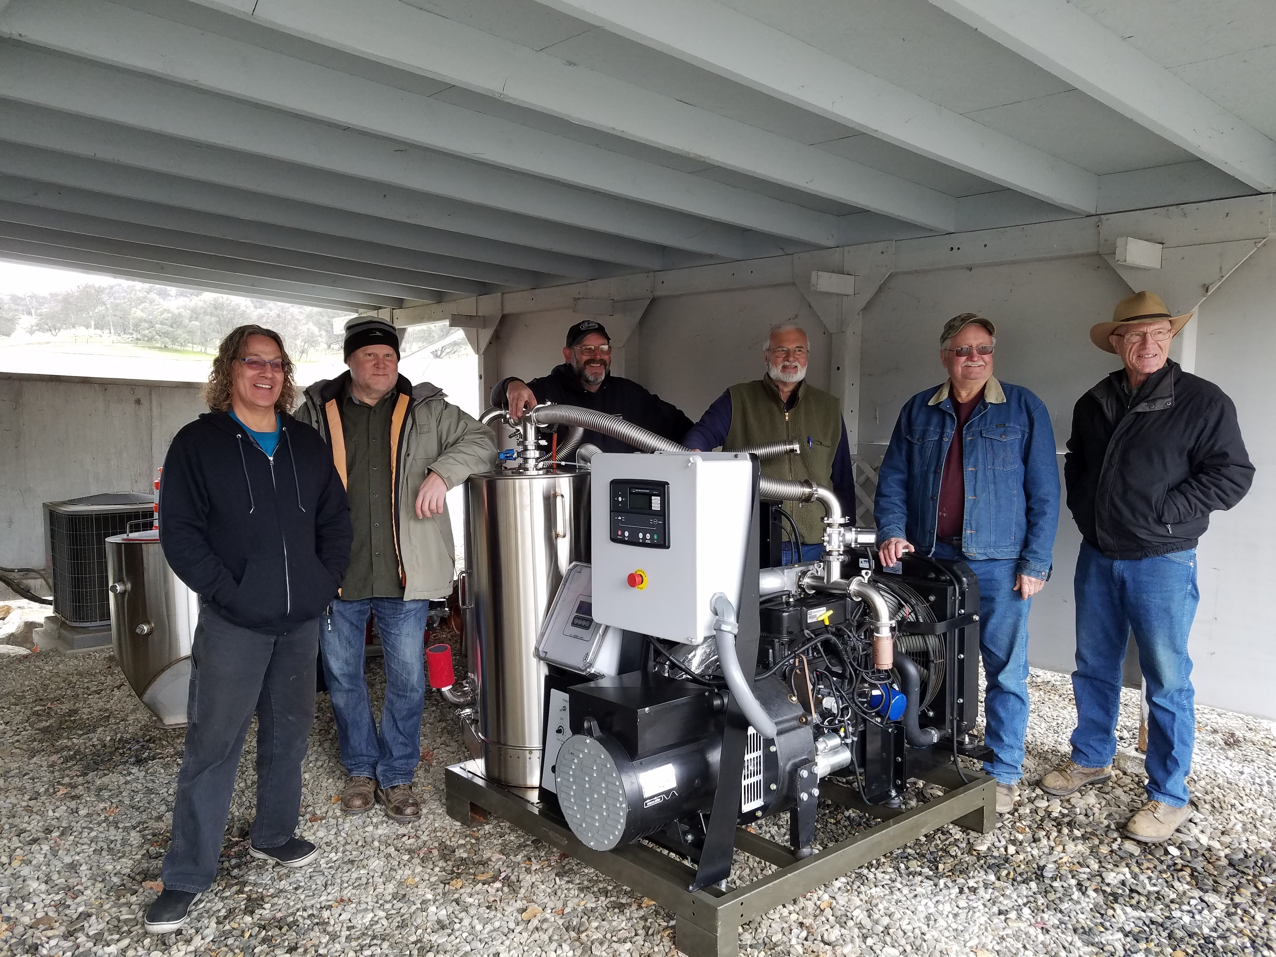
Sierra RCD Carbon Management Program
Identify and quantify opportunities to enhance on-farm carbon capture in plant biomass and soils.
Barriers (economic, regulatory, outreach, education and others).
RCD assets, needs and potential partners.
Potential sources of funding for implementation.
Introduce carbon management in the Long Range Plan.
Source: Sierra RCD

Slide 10
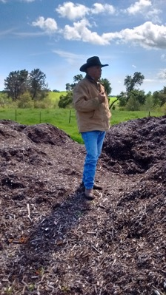
Others:
Yolo RCD:
Carbon Farm Plan for Yolo Land and Cattle
NRCS conservation field trials for compost
Demo project for Healthy Soils Program

Slide 11
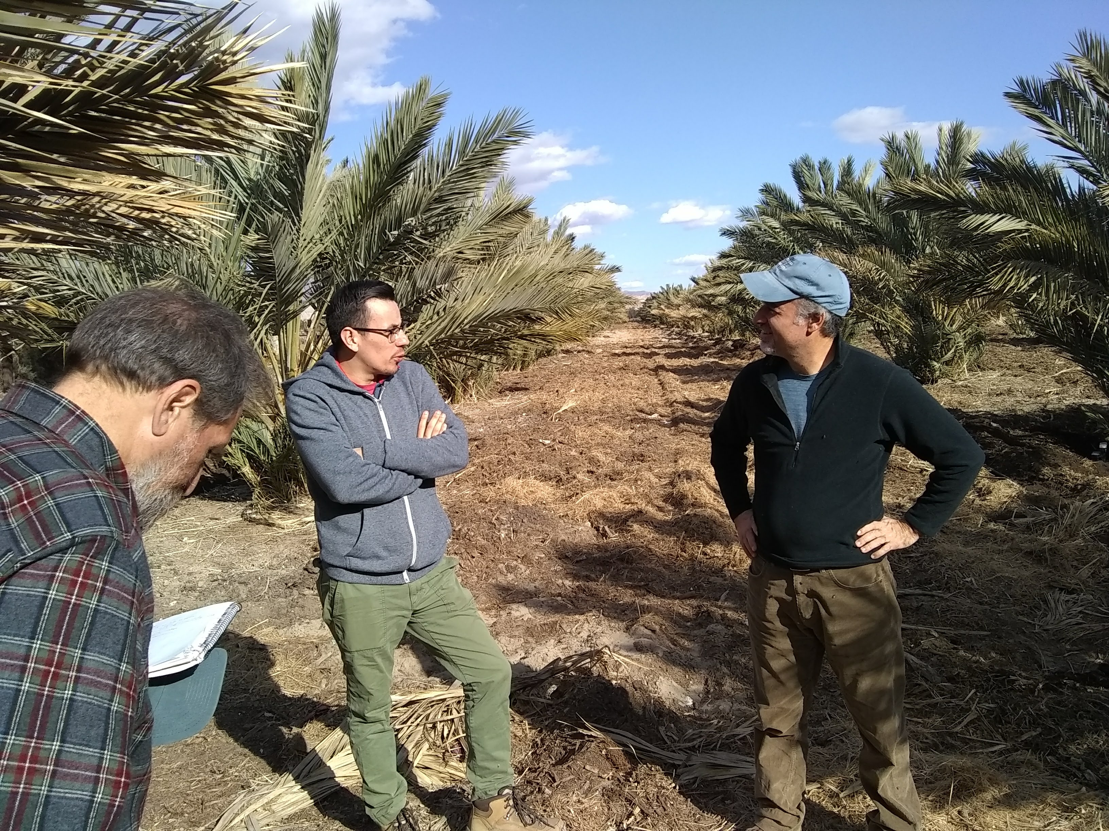
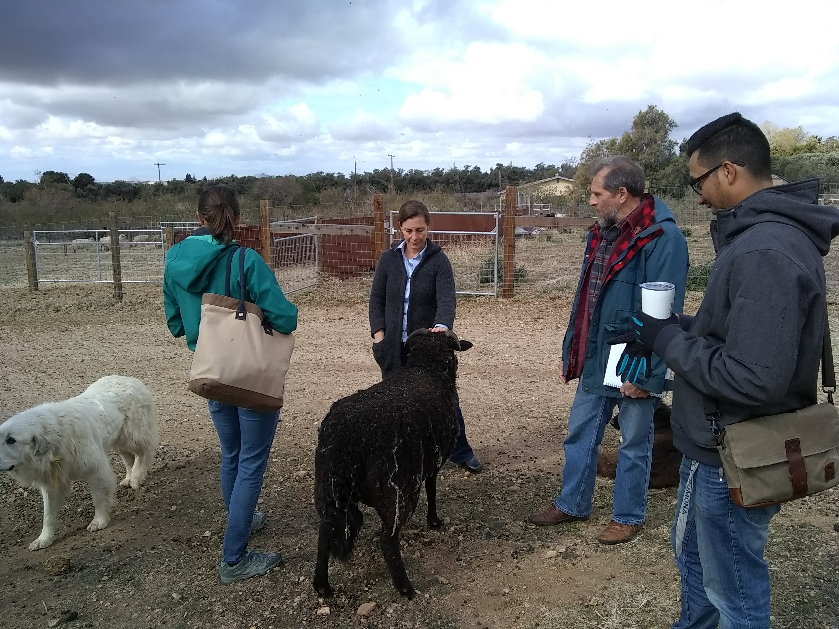
Others:
Coachella Valley RCD: Working with latino farmers growing dates
Inland Empire RCD: Carbon Farm Plan for 123 Farm
Contra Costa, Coastal San Luis, Placer

Slide 12
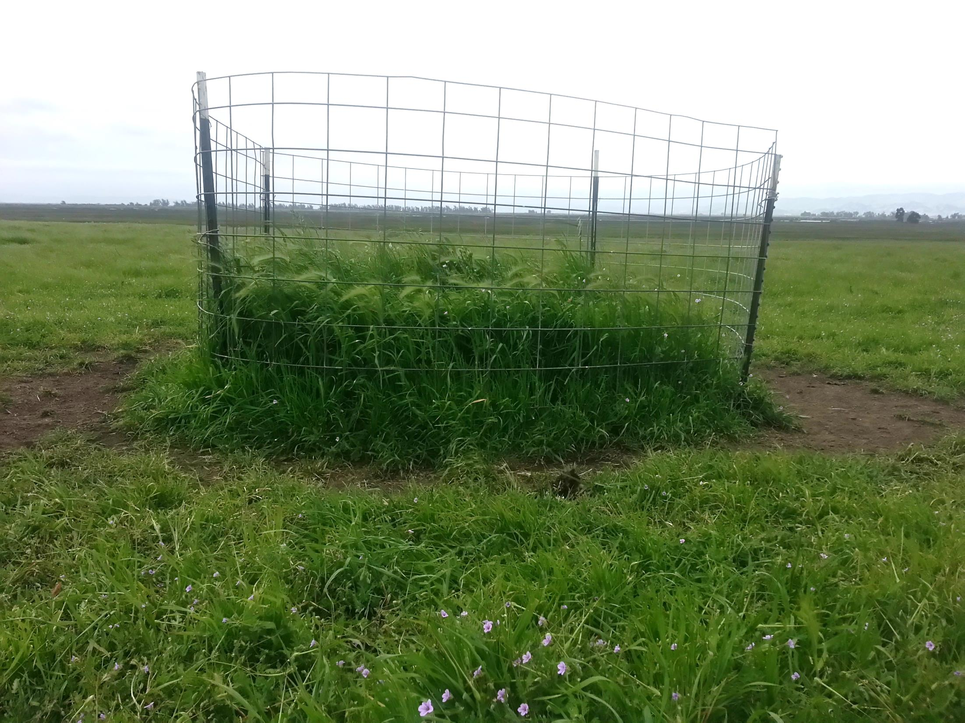
Scaling Up Carbon Farming with Land Trusts
Solano Land Trust: Costs and benefits of compost application on rangelands
Sequoia Riverlands Trust: Carbon Farm Plan for Kaweah Oaks Preserve

Slide 13
Carbon Farming Revenue
* Funding Programs
WCB, IRWMP, Prop 1
* Carbon Markets
($9-20/ton)
NRCS Incentives
Local Mitigation Funds
CAPs, CAPCOA, CEQA
State Incentives
Healthy Soils/SALC
Revenue NOT Included:
Markets for products, e.g. carbon-beneficial wool, beef, dairy products
Cost savings: Increased productivity; reduce water, feed, fertilizers, and other inputs
Stewardship/Easement Programs
Philanthropic/Donors

Slide 14
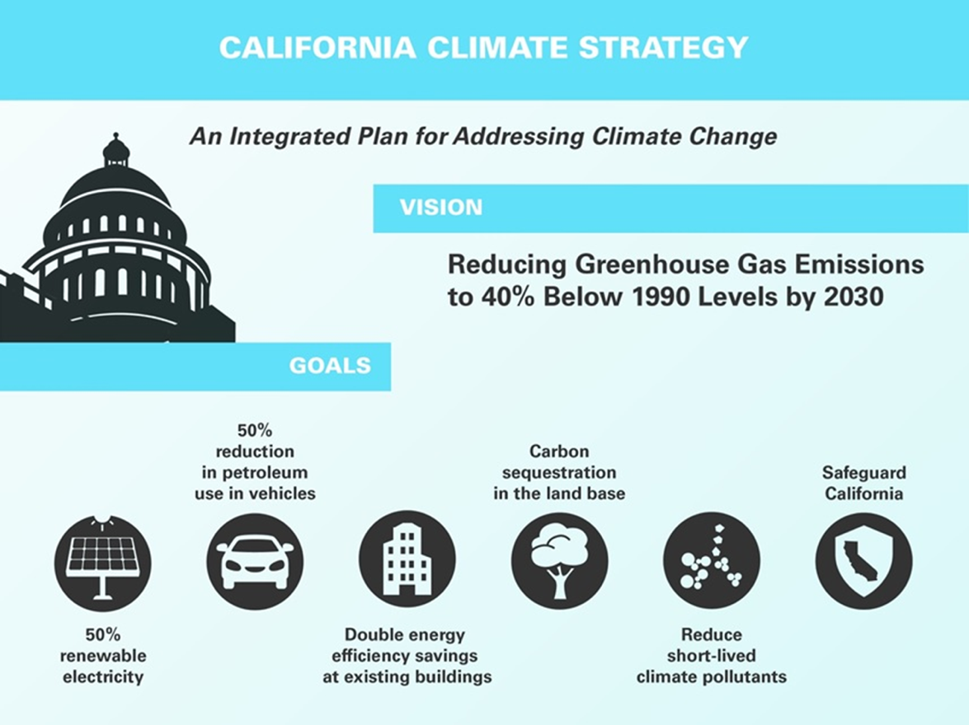
Notes:
The pillars recognize that several major areas of the California economy will need to reduce emissions to meet the 2030 greenhouse gas emissions target.
Governor Brown called for support to manage natural and working lands, including forests, rangelands, farms, wetlands, and soils, so they can store carbon. These lands have the ability to remove carbon dioxide from the atmosphere through biological processes, and to then sequester carbon in above and below-ground matter.

Slide 15
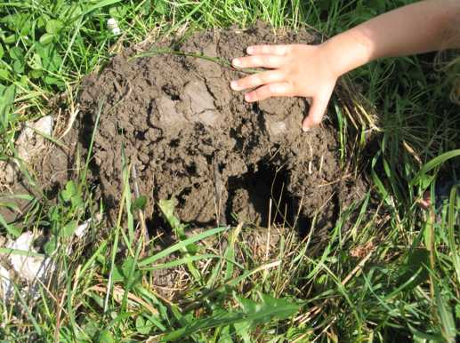
Summary
California -and the world- can only meet GHG reduction goals by investing in our soils and working lands as major sinks for atmospheric carbon.
Carbon farming provides environmental co-benefits such as increased productivity, resilience to drought and improved habitat
There is a framework for implementation based on existing infrastructure/relationships
Land trusts can be an important partner

